Slide 1
TekInspect 1.0 Moderator Training
Guidelines for leading the
Tektronix Software Inspection Method
Philip M. Johnson
Collaborative Software Development Laboratory
Department of Information and Computer Sciences
University of Hawaii
Honolulu, HI
johnson@hawaii.edu
© 1996 Philip M. Johnson
Permission to redistribute and modify freely is granted as long as this copyright notice is retained.

Slide 2
Prerequisites
TekInspect 1.0 Reviewer Training

Slide 3
Course structure
9:00 - 12:00: Lecture
12:00 - 1:00: Lunch
1:00 - 2:00: Checklist generation practice
2:00 - 3:00: Meeting moderation practice
3:00 - 3:30: Wrapup and evaluation

Slide 4
Goals for this course
Learn about Moderator “key process areas”
Learn to generate checklists.
Practice review meeting moderation.
Be ready to begin practicing review in your group.

Slide 5
Goals of Inspection Moderators
Obtain a high quality inspection, or determine why one could not be obtained.
Obtain high quality checklists and references.
Make inspection both efficient and effective.
Help reviewers to check work product thoroughly.
Facilitate review meeting and maximize productivity.
Obtain high quality measures of process.
Assess inspection process for potential improvements to:
  Inspection process itself (checklist items, review meeting)
  Software development process (standards, testing, etc.)

Slide 6
Moderator Key Process Areas
Phase Administration
Checklists
Review Meeting Facilitation
Measurement
Review method customization

Slide 7
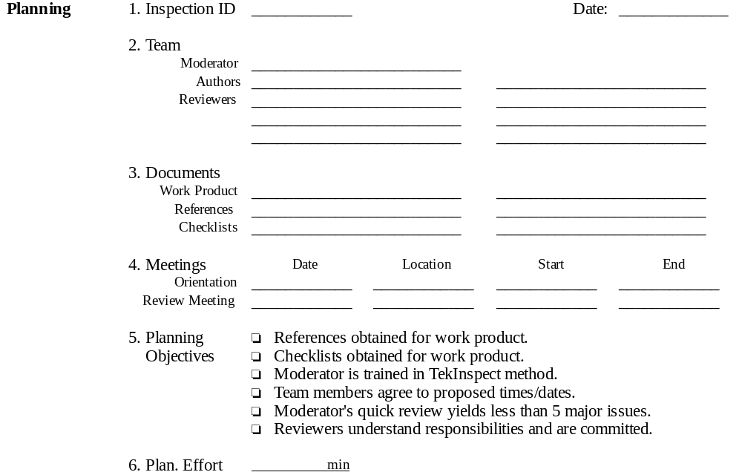
Phase Administration: Planning

Slide 8
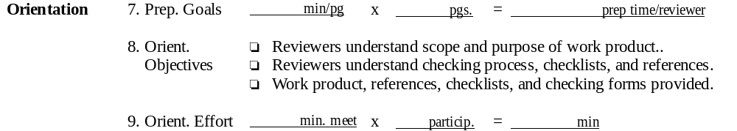
Phase Administration: Orientation

Slide 9
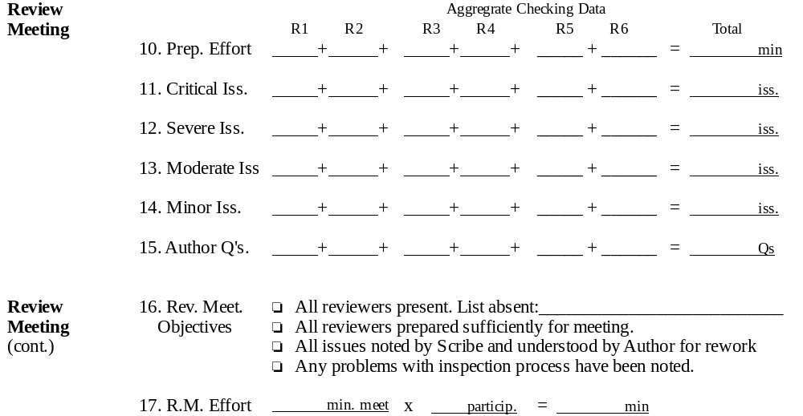
Phase Administration:
Review Meeting

Slide 10
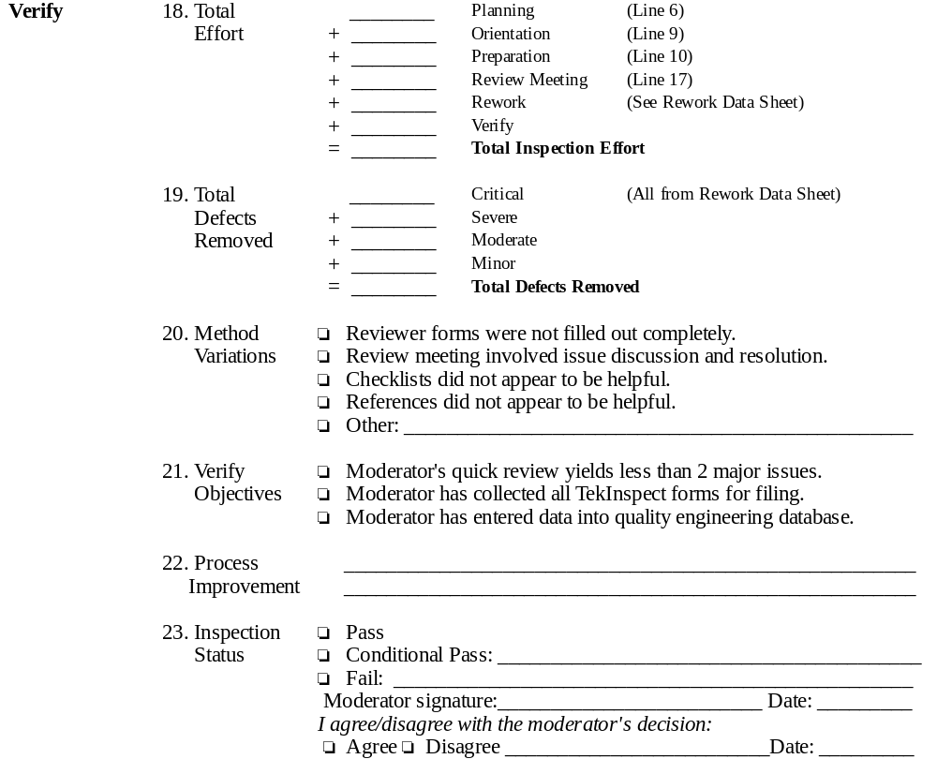
Phase Administration: Verify

Slide 11
Checklists and References
The first difficult task of moderators is to obtain useful checklists and references.
Checklists are itemized lists that guide reviewers toward defects.
References are sources of high quality information about work product:
  Corporate standards
  Textbooks
  High quality examples of similar work products.
It is the Moderator’s responsibility to build and maintain checklists!

Slide 12
Checklist perspectives
Separate checklists for the same work product can be built to utilize different perspectives:
Example: an SRS work product could have separate checklists focusing on defects from:
  Hardware engineering perspective
  Customer usability perspective
  Marketing perspective
  Software engineering perspective
  Backward/forward compatibility perspective

Slide 13
Top-down Checklist generation
Procedure:
  Find work product standards or other reference materials.
  Derive checklist items from analysis of standards.
  Example:
    Standard says: “This section should describe what the work product does and does not cover.”
    Checklist says: “Does the Scope section describe what the work product does not cover?”
Advantages of top-down checklist generation
  Checklists usually have good “coverage” of the work product.
Disadvantages of top-down checklists
  Checklists can easily become too large.
  Many top-down checklist items are not useful

Slide 14
Bottom-up Checklist Generation
Procedure:
  Analyze defect logs for re-occurring errors or classes of errors.
  Derive checklist errors from this analysis.
  Example:
    Given: Repeated defects in VRAM specification over different products and reviews.
    Checklist says: “Check VRAM specifications carefully for capacity, performance, and other errors.
  Advantages of bottom-up checklist items:
    Checklist items focus on known areas of difficulty.
    Checklist items are highly domain/task specific.
    Checklists can move defect detection “upstream”.
  Disadvantages of bottom-up checklists:
    Tend to leave “holes” in coverage.
    Require defect data collection.
    Tend to track a moving target.

Slide 15
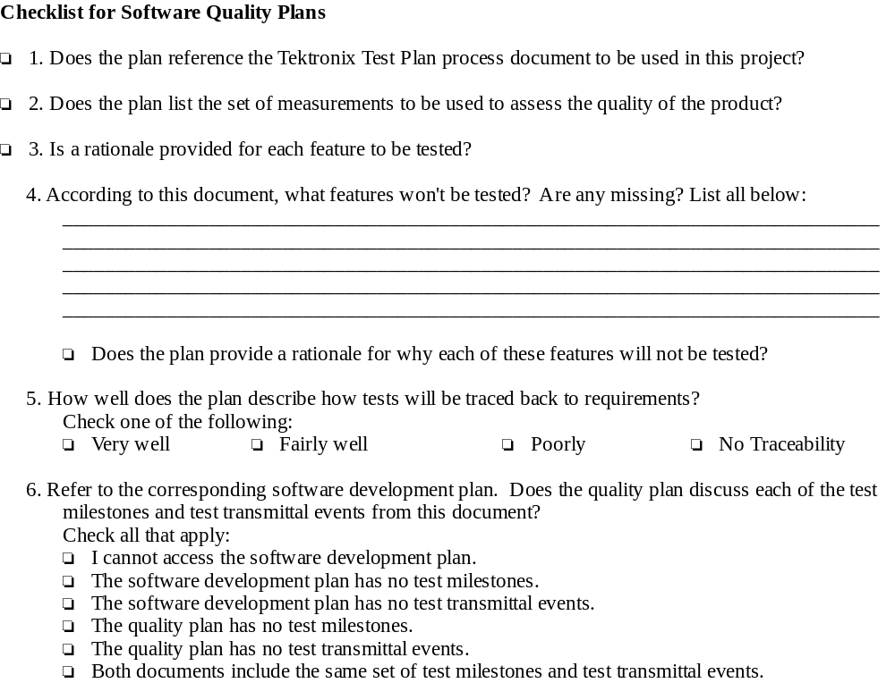
Example Checklist

Slide 16
Checklist Maintenance
Checklists must evolve over time.
Each current checklist item must be periodically re-evaluated:
  Has it been useful? Has it been used to detect any defects?
  Is it still useful? Have circumstances changed in such a way that this item is less likely to be effective in future?
  Can it be modifed to increase its defect finding capabilities?
New checklist items should be added and evaluated:
  Through top-down, standards-based generation.
  Through bottom-up, defect analysis-based generation.

Slide 17
Review Meeting Facilitation: Opening
Assess reviewer preparation effectiveness.
Explain meeting purpose and process.
Ensure that scribe’s notes will be visible:
  Laptop + projector
  Flip chart
  Overhead projector

Slide 18
Review Meeting Facilitation: Interactions
Encourage:
  fairness accomodation
  listening learning
Discourage:
  drifting into details irrelevant background
  excessive questioning defect resolution
Suppress:
  superficial rejection superficial acceptance
  emotional responses avoidance

Slide 19
Measurement
Measurement is both qualitative and quantitative:
  qualitative: participant evaluation of inspection and work product.
  quantitative: empirical measures of product and process.
Measurements are taken on both product and process
Measurement is both ‘instantaneous’ and ‘continuous’
  ‘instantaneous’ measures are available as soon as a review is completed and relate to a single work product/process only.
  ‘continuous’ measures track reviews over time, require data from multiple work product/processes, and/or require data from other software development activities.

Slide 20
‘Instantaneous’ Work Product Measures
On a single work product:
  Number of confirmed defects at each severity level
    found
    removed
    remaining
  Density of defects within the work product.

Slide 21
‘Instantaneous’ Work Process Measures
Effort spent:
  Checking the work product (preparation)
  Logging issues (review meeting)
  Verifying and removing defects (rework)
  Administrating review (all other phases)
Average cost (person-hours) per defect
  To detect
  To remove
Preparation effectiveness (% issues verified as defects)
Checklist item yield (# verified defects found using item)
Method compliance (% data sheet objectives fulfilled)
Preparation goal accuracy (% goal prep time/actual time)

Slide 22
‘Continuous’ Work Product Measures
Overall review effectiveness
  % of total number defects found in product (including testing, customer reports, etc.) that were discovered through review.
Average defects discovered/removed and
Trends in defect discovery/removal per:
  work product type
  review method type
  project type
Defect “slippage”:
  Number/type of req. defects surviving to design, imp, test, release
  Number/type of design defects surviving to imp, test, release.
  etc

Slide 23
‘Continuous’ Work Process Measures
Averages and trends in:
  Effort required per defect and per defect type.
  Preparation effectiveness
  Overall review effectiveness
  Checklist yield
  Method compliance
  Work products successfully exiting review.
“Meta-level” measurements
  Changes to review method
    Procedures
    Objectives
    Forms
  Changes to checklist items.
  Changes in adoption/use of review in organization.

Slide 24
Measurement supports process improvement
Qualitative and quantitative measures support:
  Improvements to checklists.
  Better perparation procedures.
  Shorter and more effective review meetings.
  Higher quality work products.
Which lead to:
  Improved schedule accuracy.
  Higher customer satisfaction.
  Reduced crunch time.
  Higher developer morale.

Slide 25
A Note on Cost-Benefit calculations
Basic:
  Each non-minor req/design review verified defect saves 8 person-hours downstream on average (Gilb93).
Intermediate:
  Compare:
    Average cost of review-based defect removal by type.
    Average cost of testing/maintenance defect removal by type.
Advanced:
  Derive measures of COQ components
    failure, appraisal, prevention
    Track failure vs appraisal+prevention over time.
  Raytheon estimated $15.8M savings between 1988-92 using this method (Dion93)

Slide 26
Review Method Customization
What if TekInspect is not appropriate for your group?
  The work product is not ready for inspection (requirements too vague).
  The work product is too large for inspection (10,000 lines or more).
  Checklists/reference materials not available.
  A face-to-face meeting is impossible.
  More than 6-8 people must be involved.
  The goal is other than defect removal (requirements elicitation, developer education, etc.)
Answer: Change the method carefully.
  Be sure that inspection is truly inappropriate.
  Consult the software process improvement group.
  Define the process and measure the results.

Slide 27
Steps to method customization
Requirements:
  Clarify what prevents application of inspection.
Definition
  Define a new six step process satisfying your constraints.
Evaluation:
  Determine how to measure its effectiveness.
Consult:
  Review the method with software process improvement group.
Deploy:
  Use method on a trial basis and evaluate.

Slide 28
Example method customization: Requirements
The context:
  In early SRS definition, we need group review to help elicit requirements. This requires lots of discussion not directly related to the work product. We also need group review to help build the team and get new members up to speed, so there’s a great deal of education, background discussion, and so forth.
Problems with TekInspect method:
  Defect classification scheme is inappropriate. Almost everything is an “Author Question”.
  Reviewer and Author data sheets are superfluous. We don’t need to track defect resolution, since the focus isn’t on guaranteeing that defects are detected and reliably removed. Margin notes on the work product to prime the discussion suffice.
  Issue discussion during the review meeting isn’t a bug, it’s a feature.

Slide 29
Example method customization: Definition
Planning: same as TekInspect.
Orientation:
  no Review Data Sheets distributed
  Author overview required on areas of ambiguity.
  no defect classification list.
Preparation
  All preparation noted as margin comments.
Review meeting
  Author acts as scribe.
Rework
  omitted
Verify
  omitted

Slide 30
Example method customization: Evaluation
If this method is successful, then:
  SRS work products should be of higher quality when reaching Inspection.
  New team members should integrate into group quickly.
If this method is unsuccessful, then:
  The meetings will be viewed as an unorganized waste of time.
  This method will replace TekInspect, leading to SRS defect escapes.
  Author will fail to capture important points, leading to team conflict.
Group generates methods to assess success/failure.

Slide 31
Example method customization: Consultation
Group consults with SPI group.
SPI group coordinates definition and use of this method with other similar groups, and shares experiences from prior attempts.
Method and evaluation mechanism is improved.

Slide 32
Example method customization: Deploy
Two groups try out method on a total of 10 early SRS reviews.
As a result of evaluation, the following process changes are made:
  an issue classification scheme is instituted.
The result is that subsequent inspections are even more effective and efficiently run, since urge to digress has been reduced!

